Slide 1
Lecture : Kinematics:
Forward and Inverse Kinematics
Kinematic Chains

Slide 2
Lecture 4: Kinematics:
Forward and Inverse Kinematics
Kinematic Chains
The Denavit-Hartenberg Convention

Slide 3
Lecture 4: Kinematics:
Forward and Inverse Kinematics
Kinematic Chains
The Denavit-Hartenberg Convention
Inverse Kinematics

Slide 4
Kinematic Chains
Basic Assumptions and Terminology:
A robot manipulator is composed of a set of links connected together by joints;

Slide 5
Kinematic Chains
Basic Assumptions and Terminology:
A robot manipulator is composed of a set of links connected together by joints;
Joints can be either
revolute joint (a rotation by an angle about fixed axis) prismatic joint (a displacement along a single axis)
more complicated joints (of 2 or 3 degrees of freedom) are represented as combinations of the simplest ones
•
◦
◦
◦

Slide 6
Kinematic Chains
Basic Assumptions and Terminology:
A robot manipulator is composed of a set of links connected together by joints;
Joints can be either
revolute joint (a rotation by an angle about fixed axis) prismatic joint (a displacement along a single axis)
more complicated joints (of 2 or 3 degrees of freedom) are represented as combinations of the simplest ones
•
◦
◦
◦
•
A robot manipulator with n joints will have (n + 1) links. Each joint connects two links;

Slide 7
Kinematic Chains
Basic Assumptions and Terminology:
A robot manipulator is composed of a set of links connected together by joints;
Joints can be either
revolute joint (a rotation by an angle about fixed axis) prismatic joint (a displacement along a single axis)
more complicated joints (of 2 or 3 degrees of freedom) are represented as combinations of the simplest ones
•
◦
◦
◦
•
A robot manipulator with n joints will have (n + 1) links. Each joint connects two links;
We number joints from 1 to n, and links from 0 to n. So that joint i connects links (i − 1) and i;
•

Slide 8
Kinematic Chains
Basic Assumptions and Terminology:
A robot manipulator is composed of a set of links connected together by joints;
Joints can be either
revolute joint (a rotation by an angle about fixed axis) prismatic joint (a displacement along a single axis)
more complicated joints (of 2 or 3 degrees of freedom) are represented as combinations of the simplest ones
•
◦
◦
◦
•
A robot manipulator with n joints will have (n + 1) links. Each joint connects two links;
We number joints from 1 to n, and links from 0 to n. So that joint i connects links (i − 1) and i;
The location of joint i is fixed with respect to the link (i − 1);
•
•

Slide 9
Kinematic Chains
Basic Assumptions and Terminology:
When joint i is actuated, the link i moves. Hence the link 0
is fixed;

Slide 10
Kinematic Chains
Basic Assumptions and Terminology:
When joint i is actuated, the link i moves. Hence the link 0
is fixed;
With the i^{th} joint, we associate joint variable
•


θ if joint i is revolute
d_{i} if joint i is prismatic
q =
i
i


Slide 11
Kinematic Chains
Basic Assumptions and Terminology:
When joint i is actuated, the link i moves. Hence the link 0
is fixed;
With the i^{th} joint, we associate joint variable
•


θ if joint i is revolute
d_{i} if joint i is prismatic
q =
i
i

•
For each link we attached rigidly the coordinate frame,
o_{i}x_{i}y_{i}z_{i} for the link i;

Slide 12
Kinematic Chains
Basic Assumptions and Terminology:
When joint i is actuated, the link i moves. Hence the link 0
is fixed;
With the i^{th} joint, we associate joint variable
•


θ if joint i is revolute
d_{i} if joint i is prismatic
q =
i
i

•
For each link we attached rigidly the coordinate frame,
o_{i}x_{i}y_{i}z_{i} for the link i;
When joint i is actuated, the link i and its frame experience a motion;
•

Slide 13
Kinematic Chains
Basic Assumptions and Terminology:
When joint i is actuated, the link i moves. Hence the link 0
is fixed;
With the i^{th} joint, we associate joint variable
•


θ if joint i is revolute
d_{i} if joint i is prismatic
q =
i
i

•
For each link we attached rigidly the coordinate frame,
o_{i}x_{i}y_{i}z_{i} for the link i;
When joint i is actuated, the link i and its frame experience a motion;
The frame o₀x₀y₀z₀ attached to the base is referred to as inertia frame
•
•

Slide 14
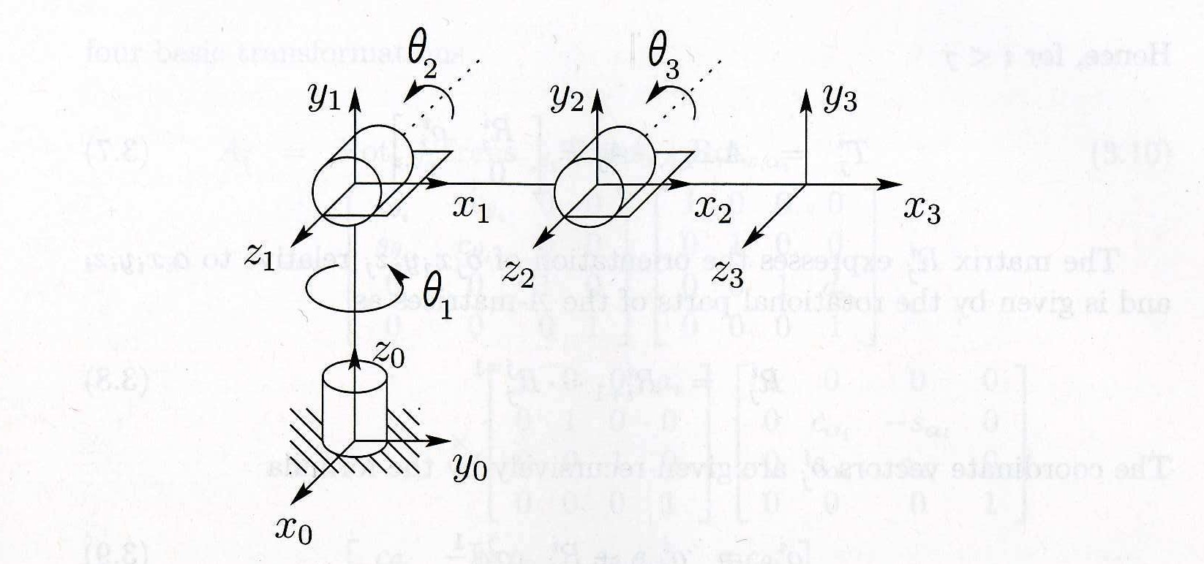
Kinematic Chains
Coordinate frames attached to elbow manipulator

Slide 15
Kinematic Chains
Basic Assumptions and Terminology:
Suppose A_{i} is the homogeneous transformation that gives
◦
◦
position orientation
of frame o_{i}x_{i}y_{i}z_{i} with respect to frame o_{i−1}x_{i−1}y_{i−1}z_{i−1};

Slide 16
Kinematic Chains
Basic Assumptions and Terminology:
Suppose A_{i} is the homogeneous transformation that gives
◦
◦
position orientation
of frame o_{i}x_{i}y_{i}z_{i} with respect to frame o_{i−1}x_{i−1}y_{i−1}z_{i−1}; The matrix A_{i} is changing as robot configuration changes;
•

Slide 17
Kinematic Chains
Basic Assumptions and Terminology:
Suppose A_{i} is the homogeneous transformation that gives
of frame o_{i}x_{i}y_{i}z_{i} with respect to frame o_{i−1}x_{i−1}y_{i−1}z_{i−1}; The matrix A_{i} is changing as robot configuration changes;
Due to the assumptions A_{i} = A_{i}(q_{i}), i.e. it is the function of a scalar variable;
◦
◦
position orientation
•
•

Slide 18
Kinematic Chains
Basic Assumptions and Terminology:
Suppose A_{i} is the homogeneous transformation that gives
◦
◦
position orientation
of frame o_{i}x_{i}y_{i}z_{i} with respect to frame o_{i−1}x_{i−1}y_{i−1}z_{i−1}; The matrix A_{i} is changing as robot configuration changes;
Due to the assumptions A_{i} = A_{i}(q_{i}), i.e. it is the function of a scalar variable;
Homogeneous transformation that expresses the position and orientation of o_{j}x_{j}y_{j}z_{j} with respect to o_{i}x_{i}y_{i}z_{i}
•
•
•
.
Ai+1Ai+2 · · · Aj−1Aj,
if i < j
if i = j
T
i
=
, T^{i} = (T^{j})⁻¹, if i > j
j i
j
I,
is called a transformation matrix

Slide 19
Kinematic Chains
If the position and orientation of the end-effector with respect to the inertia frame are
o⁰ ,
_{R}0
n n
Then the position and orientation of the end-effector in inertia frame are given by homogeneous transformation
Σ
Σ
_{R}0 0
_{n} o
T ⁰ = A (q )A (q ) · · · A_{n−1}(q_{n−1})A_{n}(q_{n}) =
n
n
1 1 2 2
0 1
Σ Σ
R
i−1 i−1 i
0
with
o_{i}
A (q ) =
i i
1

Slide 20
Kinematic Chains
If the position and orientation of the end-effector with respect to the inertia frame are
o⁰ ,
_{R}0
n n
Then the position and orientation of the end-effector in inertia frame are given by homogeneous transformation
Σ
Σ
_{R}0 0
_{n} o
T ⁰ = A (q )A (q ) · · · A_{n−1}(q_{n−1})A_{n}(q_{n}) =
n
n
1 1 2 2
0 1
Σ Σ
R
i−1 i−1 i
0
with
o_{i}
A (q ) =
i i
1
Σ
Σ
_{R}i i
_{j} o
i
j
0 1
⇒ T_{j}
= Ai+1Ai+2
· · · A
j−1Aj =
with
_{R}i
= R^{i}
· · · R^{j−1},
_{o}i
= o^{i} + R^{i}
_{o}j
j
i+1
j
j
j−1
j−1 j−1

Slide 21
Lecture 4: Kinematics:
Forward and Inverse Kinematics
Kinematic Chains
The Denavit-Hartenberg Convention
Inverse Kinematics

Slide 22
DH Convention:
The idea is to represent each homogeneous transform A_{i} as a product
A_{i} = Rot_{z,θi} ·Trans_{z,di} ·Trans_{x,ai} ·Rot_{x,αi}
 



0 0 1 0 0 0 1 0 0 a 1 0 0
0 0 0 1 0 0 0 1 0 0 0 c −s 0
0 1 0 0 0 1 d 0 0 1 0 0 0
c −s_{θi}
i
0
θ
i
s
c




₌ θ

θ_{i}
α
α

i



i
i

0
i

s
α
c
α
i
i
0
0 0 1 0 0 0 1 0 0 0 1 0 0
0
1

Slide 23
DH Convention:
The idea is to represent each homogeneous transform A_{i} as a product
A_{i} = Rot_{z,θi} ·Trans_{z,di} ·Trans_{x,ai} ·Rot_{x,αi}
 



0 0 1 0 0 0 1 0 0 a 1 0 0
0 0 0 1 0 0 0 1 0 0 0 c −s 0
0 1 0 0 0 1 d 0 0 1 0 0 0
c −s_{θi}
i
0
θ
i
s
c




₌ θ

θ_{i}
α
α

i



i
i

0
i

s
α
c
α
i
i
0
0 0 1 0 0 0 1 0 0 0 1 0 0
0
1
The parameters of transform are known as
•
•
•
•
a_{i}: link length α_{i}: link twist d_{i}: link offset θ_{i}: link angle

Slide 24
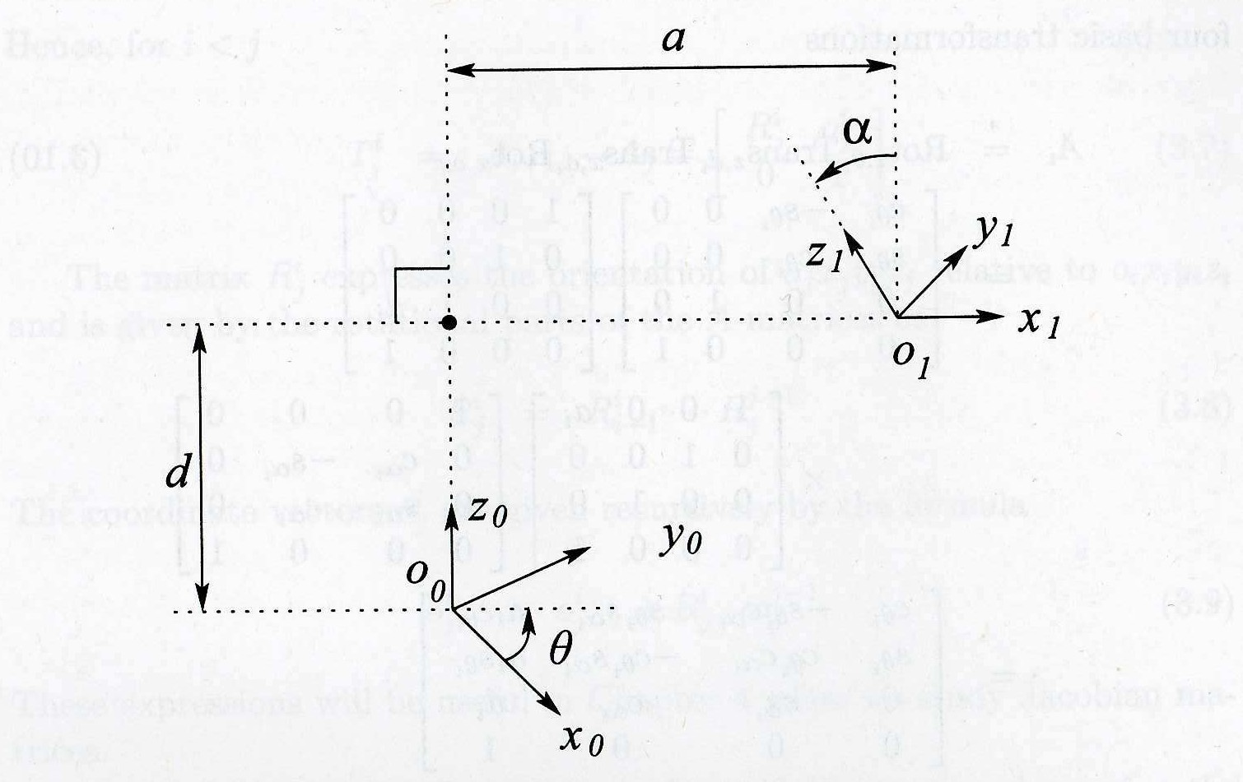
Conditions for Existence 4 Parameters:
DH1: The axis x₁ is perpendicular to the axis z₀
DH2: The axis x₁ intersects the axis z₀

Slide 25
Assigning Frames Following DH-Convention:
Given a robot manipulator with
n revolute and/or prismatic joints
(n + 1) links
•
The task is to define coordinate frames for each link so that transformations between frames can be written in
DH-convention

Slide 26
Assigning Frames Following DH-Convention:
Given a robot manipulator with
n revolute and/or prismatic joints
(n + 1) links
•
The task is to define coordinate frames for each link so that transformations between frames can be written in
DH-convention
The algorithm of assigning (n + 1) frames for (n + 1) links
treats separately first n-frames and the last one (end-effector frame)
is recursive in first part, so that it is generic

Slide 27
Assigning First n-Frames
Step 1 (Choice of z-axises):
Choose z₀-axis along the actuation line of the 1st-link;

Slide 28
Assigning First n-Frames
Step 1 (Choice of z-axises):
Choose z₀-axis along the actuation line of the 1st-link;
Choose z₁-axis along the actuation line of the 2nd-link;

Slide 29
Assigning First n-Frames
Step 1 (Choice of z-axises):
Choose z₀-axis along the actuation line of the 1st-link; Choose z₁-axis along the actuation line of the 2nd-link;
. . .
Choose z_{(n−1)}-axis along the actuation line of the n^{th}-link
•
•
•

Slide 30
Assigning First n-Frames
Step 1 (Choice of z-axises):
Choose z₀-axis along the actuation line of the 1st-link; Choose z₁-axis along the actuation line of the 2nd-link;
. . .
Choose z_{(n−1)}-axis along the actuation line of the n^{th}-link
•
•
•
We need to finish the job and assign
point on each of z_{i}-axis that will be the origin of the
i^{th}-frame
x_{i}-axis for each frame so that two DH-conditions hold
DH1: The axis x₁ is perpendicular to the axis z₀
DH2: The axis x₁ intersects the axis z₀ y_{i}-axis for each frame
•
•

Slide 31
Assigning First n-Frames
Step 2 (Choice of x-axises):
Suppose that we have chosen the (i − 1)^{th}-frame and need to proceed with the i^{th}-frame

Slide 32
Assigning First n-Frames
Step 2 (Choice of x-axises):
Suppose that we have chosen the (i − 1)^{th}-frame and need to proceed with the i^{th}-frame
For the i^{th}-frame, the z_{i} axis is already fixed
•

Slide 33
Assigning First n-Frames
Step 2 (Choice of x-axises):
Suppose that we have chosen the (i − 1)^{th}-frame and need to proceed with the i^{th}-frame
For the i^{th}-frame, the z_{i} axis is already fixed To meet conditions DH1-DH2
the x_{i}-axis should intersects z_{i−1} and x_{i}⊥z_{i−1} and x_{i}⊥z_{i}. Is it possible?
•
•

Slide 34
Assigning First n-Frames
Step 2 (Choice of x-axises):
Suppose that we have chosen the (i − 1)^{th}-frame and need to proceed with the i^{th}-frame
For the i^{th}-frame, the z_{i} axis is already fixed To meet conditions DH1-DH2
the x_{i}-axis should intersects z_{i−1} and x_{i}⊥z_{i−1} and x_{i}⊥z_{i}. Is it possible?
There are 3 cases:
•
•
•
z_{i} and z_{i−1} are not coplanar
z_{i} and z_{i−1} are parallel
z_{i} and z_{i−1} intersect
◦
◦

Slide 35
Assigning First n-Frames
Step 2 (Choice of x-axises):
Suppose that we have chosen the (i − 1)^{th}-frame and need to proceed with the i^{th}-frame
For the i^{th}-frame, the z_{i} axis is already fixed To meet conditions DH1-DH2
the x_{i}-axis should intersects z_{i−1} and x_{i}⊥z_{i−1} and x_{i}⊥z_{i}. Is it possible?
There are 3 cases:
•
•
•
z_{i} and z_{i−1} are not coplanar
z_{i} and z_{i−1} are parallel
z_{i} and z_{i−1} intersect
◦
◦
•
For all 3 cases it is possible!

Slide 36
Assigning First n-Frames
Step 2 (Choice of x-axises):
If z_{i} and z_{i−1} are not coplanar, then there is the common perpendicular for both lines!

Slide 37
Assigning First n-Frames
Step 2 (Choice of x-axises):
If z_{i} and z_{i−1} are not coplanar, then there is the common perpendicular for both lines!
It will define new origin o_{i} and the x_{i}-axis for the i^{th}-frame

Slide 38
Assigning First n-Frames
Step 2 (Choice of x-axises):
If z_{i} and z_{i−1} are not coplanar, then there is the common perpendicular for both lines!
It will define new origin o_{i} and the x_{i}-axis for the i^{th}-frame
If z_{i} and z_{i−1} are parallel, then there are many common perpendiculars for both lines!

Slide 39
Assigning First n-Frames
Step 2 (Choice of x-axises):
If z_{i} and z_{i−1} are not coplanar, then there is the common perpendicular for both lines!
It will define new origin o_{i} and the x_{i}-axis for the i^{th}-frame
If z_{i} and z_{i−1} are parallel, then there are many common perpendiculars for both lines!
One of them will define new origin o_{i} and the x_{i}-axis for the
i^{th}-frame

Slide 40
Assigning First n-Frames
Step 2 (Choice of x-axises):
If z_{i} and z_{i−1} are not coplanar, then there is the common perpendicular for both lines!
It will define new origin o_{i} and the x_{i}-axis for the i^{th}-frame
If z_{i} and z_{i−1} are parallel, then there are many common perpendiculars for both lines!
One of them will define new origin o_{i} and the x_{i}-axis for the
i^{th}-frame
If z_{i} and z_{i−1} intersect, then there is a vector orthogonal to the plane formed by z_{i} and z_{i−1}!

Slide 41
Assigning First n-Frames
Step 2 (Choice of x-axises):
If z_{i} and z_{i−1} are not coplanar, then there is the common perpendicular for both lines!
It will define new origin o_{i} and the x_{i}-axis for the i^{th}-frame
If z_{i} and z_{i−1} are parallel, then there are many common perpendiculars for both lines!
One of them will define new origin o_{i} and the x_{i}-axis for the
i^{th}-frame
If z_{i} and z_{i−1} intersect, then there is a vector orthogonal to the plane formed by z_{i} and z_{i−1}!
The point of intersection can be new origin o_{i} and the x_{i}-axis for the i^{th}-frame is the orthogonal to this plane

Slide 42
Assigning First n-Frames
Step 3 (Choice of y-axises):
If we have already chosen the vectors z_{i}, x_{i} and the point o_{i} for the i^{th}-frame, y_{i} can be assigned by

Slide 43
Assigning First n-Frames
Step 3 (Choice of y-axises):
If we have already chosen the vectors z_{i}, x_{i} and the point o_{i} for the i^{th}-frame, y_{i} can be assigned by
cross-product operation: y˙_{i} = z˙_{i} × x˙_{i}

Slide 44
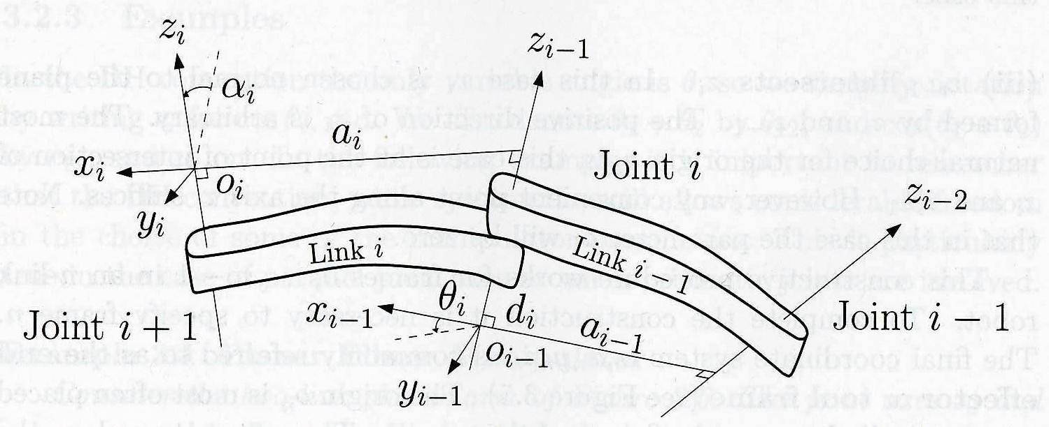
Illustration of DH-frame assignment

Slide 45
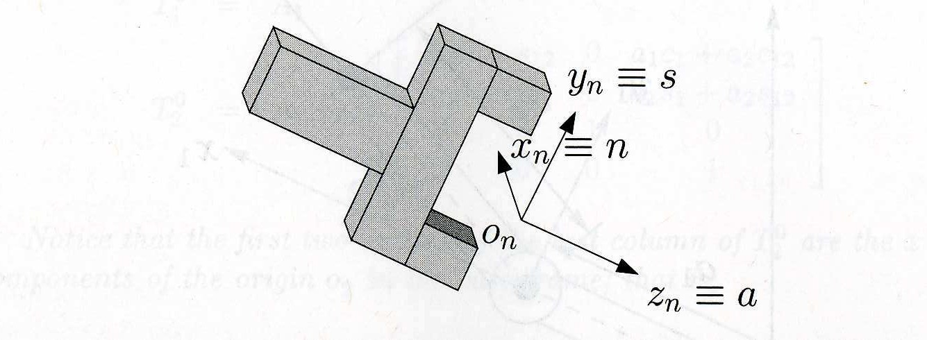
Assigning the Last Frame for the End-Effector
For most robots z_{n−1} and z_{n} coincide. So that the transformation between two frames is
•
•
translation by d_{n} along z_{n−1}-axis rotation by θ_{n} about z_{n}-axis

Slide 46
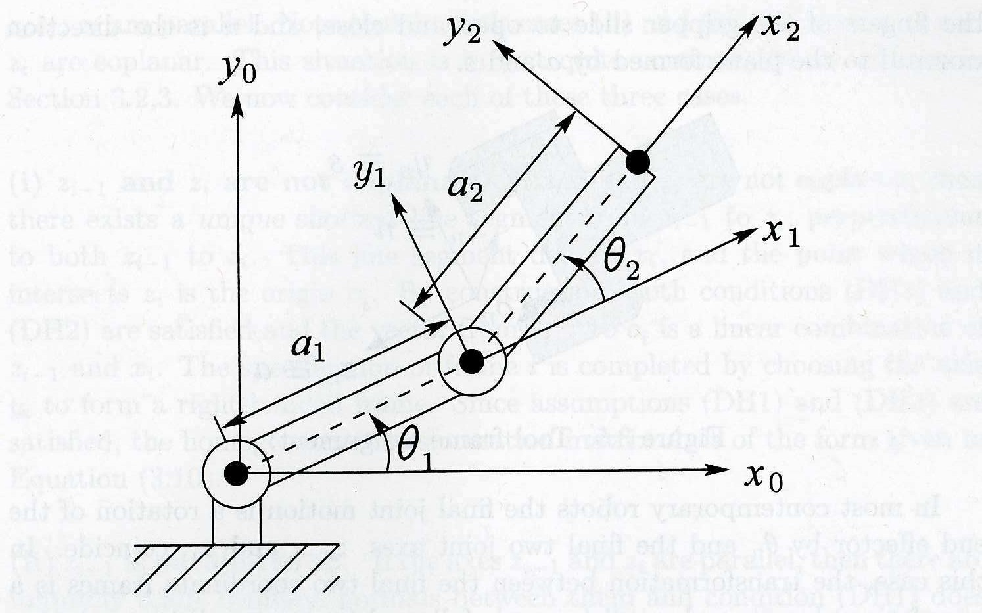
Example 3.1: Planar two-link manipulator

Slide 47
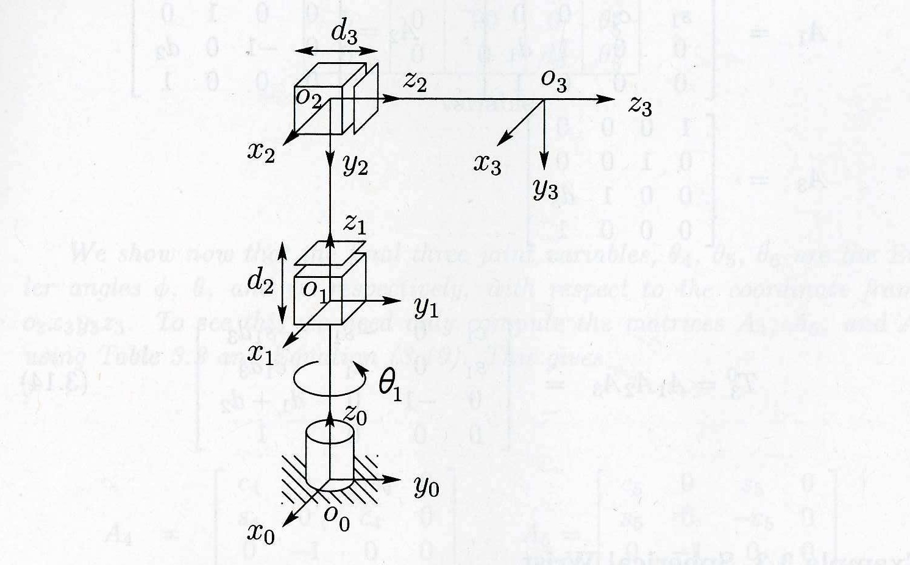
Example 3.2: Three-link cylindrical manipulator

